Slide 1

Cpsc1517
Test Driven Development

Slide 2
Lesson Objective
By the end of this lesson, learners should be able to:
  Test-Driven Development (TDD), including the Red-Green-Refactor cycle, its benefits, and a step-by-step coding example using C#. Learn how to write tests before implementation to improve code quality, design, and reliability.

Slide 3
AGENDA
Introduction to TDD
What is TDD
Benefits of TDD
Step by Step Implementation of TDD
When to use TDD
Key Practices in TDD

Slide 4
Exploring the Topic

Slide 5
Test Driven Development (TDD)
Test-Driven Development (TDD) is a software development methodology that emphasizes writing tests before writing the actual code.
This approach ensures that the software is reliable, maintainable, and bug-free.
In TDD, development is divided into short iterations based on a three-step cycle: Red, Green, and Refactor.

Slide 6
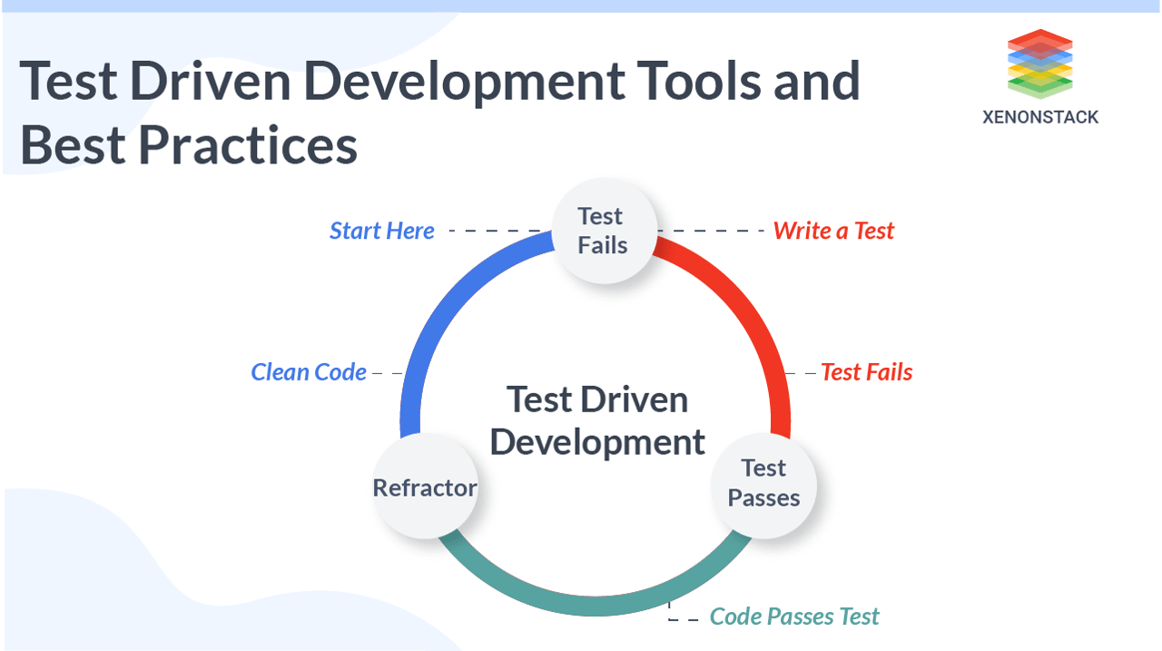
Red: Write a test for new feature or behavior that fails initially because the code does noy exist yet.
Green: Write just enough code to pass the test. This means creating the simplest implementation that makes the test succeed.
Refactor: Improve the code by refactoring while ensuring that all tests still pass. This step is where you clean up the code for readability and efficiency.
Source: https://images.app.goo.gl/75ZpZfbGqr2pckGi8

Slide 7
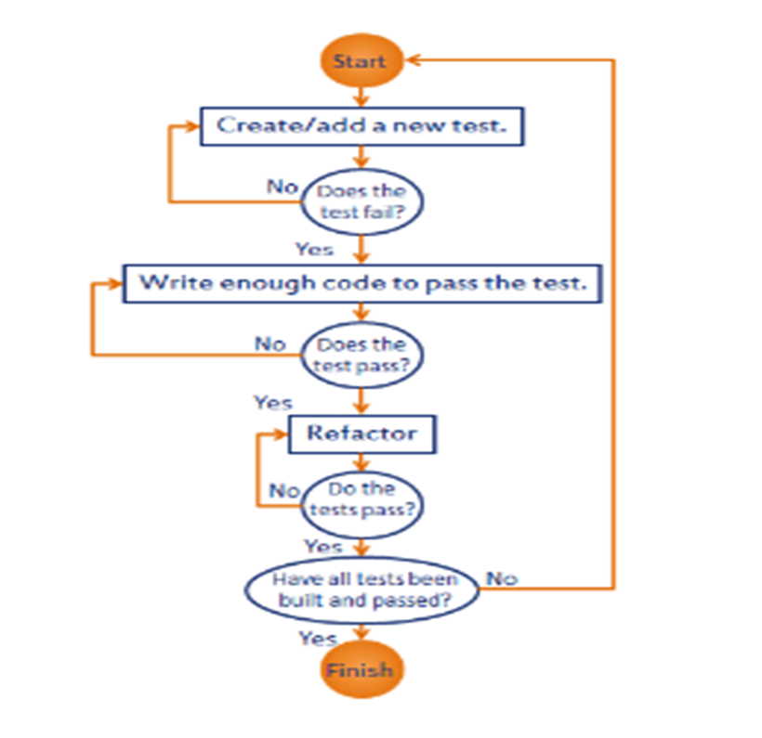
TDD Cycle:
Ensures that the code meets the specified requirements and is tested from the very beginning.
Source: https://images.app.goo.gl/SuGtu4bGBh7xw5AV8

Slide 8
Benefits of TDD
Early Bug Detection: By testing each unit of your code as you write it, you can catch bugs early-before they pile up into bigger issues.
Documentation: Unit tests serve as documentation for your code. If you come back to a project after a few months, the tests tell you what each method is supposed to do.
Facilitates Refactoring: When you need to change your code, unit tests provide a safety net. They ensure that any new changes don’t accidently break existing functionality.
Improved Code Design: Writing Unit tests forces you to think about how your code is structured. As a result, your code tends to be cleaner and more modular.

Slide 9
What is Unit Test ?
Unit Tests basically test individual parts of code.
A Unit Test is a code written by any programmer which test small pieces of functionality of big programs.
Generally, the tests cases are written in the form of functions that will evaluate and determine whether a returned value after performing Unit Test is equals to the value you were expecting when you wrote the function.
The main objective in unit testing is to isolate a unit part of code and validate its to correctness and reliable.

Slide 10
All test methods are divided into three sessions
Arrange, Act, Assert” (AAA) is a pattern commonly used in unit testing to structure and organize test code. It provides a clear and systematic approach to writing test cases.
Arrange: The Arrange phase is where you set up the preconditions or the initial state for your test.
Act: The Act phase is where you invoke the actual method or function that you want to test.
Assert: The Assert phase is where you verify the outcome of the action performed in the Act phase. You check whether the actual results match the expected results or conditions.

Slide 11
Optimizing Test Code with xUnit Attributes
[Fact]: Marks a test method that should always be executed by the test runner.
Fact annotation is used to describe a single test method without a parameter, they are mainly used for simple test cases.
[Theory]: Marks a test method that should be executed with multiple input values, specified using the [InlineData] attribute.
[InlineData]: Specifies input values for a parameterized test method marked with the [Theory] attribute.

Slide 12
Optimizing Test Code with xUnit Attributes
Theory annotations are similar to Fact, but they are parameterized. It allows you to write a single test method that can be executed with multiple sets of inputs. Theories are annotated with [Theory] and use attributes like [InlineData] to provide different test cases.

Slide 13
Step by step Implementation of TDD
Sample Requirements:
A higher sales amount results in a higher discount.
  The discount percentage should be determined based on predefined ranges:
    Sales amount below 100: 0% discount
    Sales amount between 100 and 500: 10% discount
    Sales amount between 500 and 1000: 20% discount
    Sales amount above 1000: 30% discount
Calculate the final price based on the discount percentage.

Slide 14
Practice
Running Unit Tests using Visual studio 2022
  Create Test Project
  Add xUnit package
  Write Unit Tests and run

